Slide 1


SAP UI5 & FIORI with OData TRAINING using BAS
Anubhav Oberoy
Day – 6

Slide 2

Agenda – Day 6
Types of Data Binding Syntax
Types of Binding
Hook Methods of Controller
Modularization of model
Binding Modes.
Concept of Named Model
How to create Named Model
Expression Binding
Aggregation Binding
Changing the default Model at run time
Element Binding
Event Object concept
What is Resource Model.
Steps to create a Resource Model. XML Model
Resource Model
Concept of BaseController
Formatter
How to create a formatter
Using the predefined Formatter Classes
User Experience V/S User Interface
UI5 vs Fiori
What is Fiori?

Slide 3

Types of Binding
SAP UI5 have 4 types of Binding options:
Property Binding
Expression Binding
Aggregation Binding
Element Binding
Property Binding:-
When we bind property of a UI control, to the address/path of the model, this is called property binding. E.g., value property of Input control was connected to /emp/empId
All the four syntaxes we studied in previous slide are the example of property binding.
Ex:-
In XML view:-
<Text text=“{/emp/empId}” ></Text>
In controller: -
this.getView().byId(“controlId”).bindProperty(“text”, ‘/emp/empId’);

Slide 4
Different Methods to Bind Property in View
Binding using the path of the data
{/empStr/empId}
Binding as property specific method:
this.getView().byId(‘controlId’).bindValue(‘/empStr/empSalary’)
Binding as property generic method:
this.getView().byId(‘controlId’).bindProperty(‘value’ , ‘/empStr/empSalary’ )
Binding using the path expression , this is also know as complex binding syntax
{path : ‘/empStr/empId’}
this syntax is helpful when we use formatter .
this syntax will not work by default until we inform it to the SAPUI5, to make this syntax work we have to add a line
code inside the bootstrap code of the application.
data-sap-ui-bindingSyntax= “complex”
Name of the property with which we want to bind

Slide 5
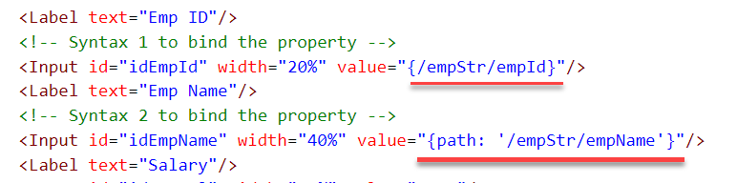
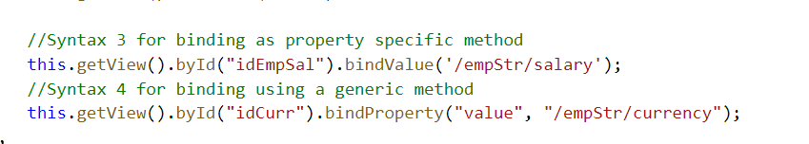
Hands – on: Binding Syntax
Now we will see the different syntax of binding the properties in the View.
Along with that we will see how to align the label and fields in the SimpleForm control.
Code Links:-
MyXML.view.xml
Main.controller.js
Index.html

Slide 6
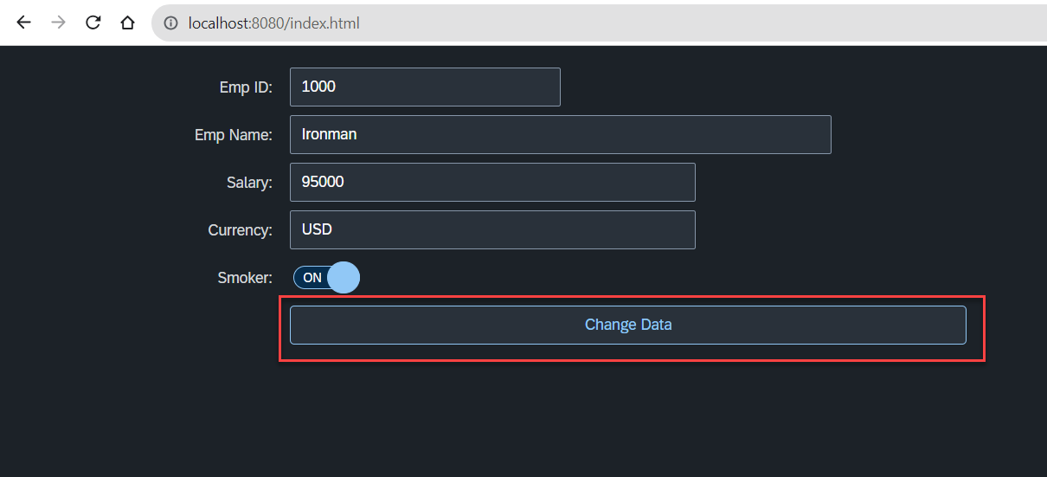
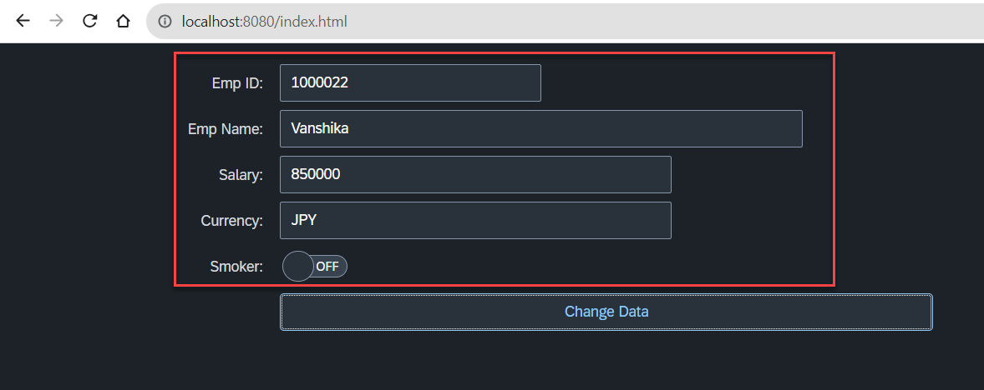
Hands – on: Changing data using Model
Now we will change the form data using the setProperty and getProperty functions.
Initially we used these functions to set the data directly now we will use the Model to change the data.
This process will be done on click of the Change Data button.
Code Links:-
MyXML.view.xml
Main.controller.js

Slide 7
Hook Method of Controller
onInit()
onBeforeRendering()
It is a function which gets called immediately after UI5 creates the object of our controller. It is like constructure of a class. We can use this to initialize our class variable
It is a method which gets called MULTIPLE times, Before every time the view is displayed to the user. We can use this method for pre-processing on a view.
IN
BR
EX
AR
onExit()
onAfterRendering()
It is a function which gets called before the instance of our controller gets destroyed. It is like destructor of a class.
We can use this to write clean-up code.
It is a method which gets called MULTIPLE times, After every time the view is displayed to the user. This method can be used to show effects to the user.

Slide 8
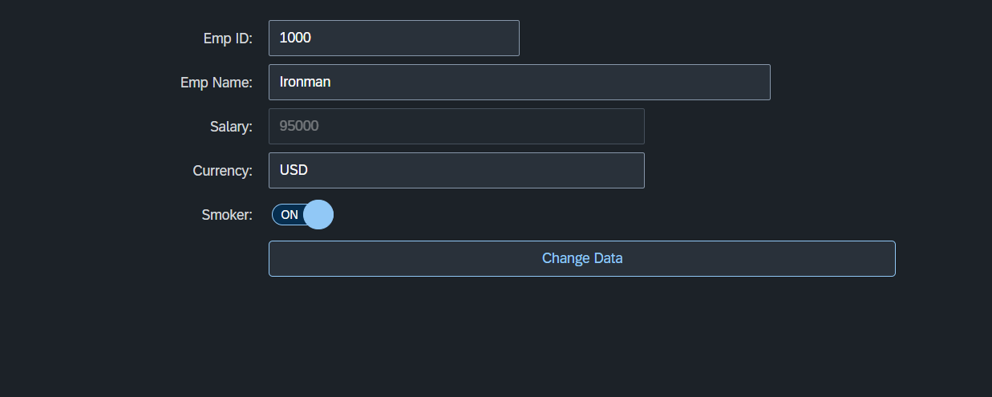
Hands – on: Hook Methods and Global Variable
Now we will see how to create a global variable and use it.
We will also see the use of Hook Methods of a controller.
Code Links:-
MyXML.view.xml
Main.controller.js

Slide 9
Binding Modes
There are basically three modes of binding data in SAPUI5.
One-way binding – Here, the data is transported in one direction only, i.e., from the model, through the binding instance to the consumer (usually the property of a control), but never in the other direction. Any change done on the model data from the front end is not affected to the model. All the data changes are reflected only on the controls.
Two-way binding – Here all input changes done from front end controls are reflected on the model and the backend database. SAPUI5 automatically handles the transport of data both from the model to the controls and back from the controls to the model. It is the default binding mode.
One-time binding – Here all data will be bound from model to view just once. After that, the connection is no more set.
Data
Data
Model
View
Model
View
Data
One-way binding
Two-way binding
Data
Data
Data
Model
View
Model
View
One-Time binding

Slide 10
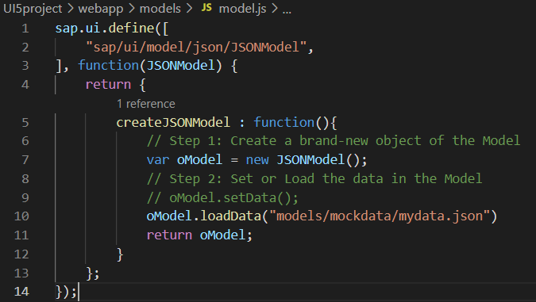
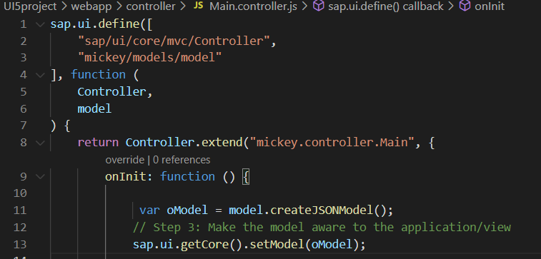
Modularization of Model
1. Create a folder in webapp with name models.
2. Inside models create a file name model.js and then create the function named createJSONModel: function(){}
3. Now create a folder inside the models named mockdata and then inside mockdata create a file named mydata.json
4. Inside the mydata.json put all the data in JSON format.
5. Then inside the models.js :-
6. Then call the model.js inside the controller and create the object then by using the object call the function of model.js
Loading the data from mydata.json using loadData() function
Call the model.js into the controller as dependency.
Object of the model.js
Call the createJSONModel function using the object

Slide 11
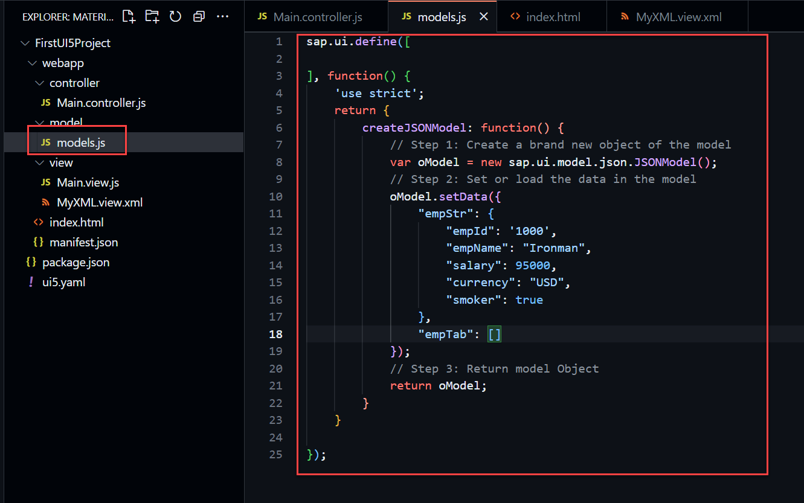
Hands – on: Modularize the Code
Now modularize our model code using the steps shown in the previous slide.
We will also see how to load the data form the model.
Code Links:-
Main.controller.js
models.js

Slide 12
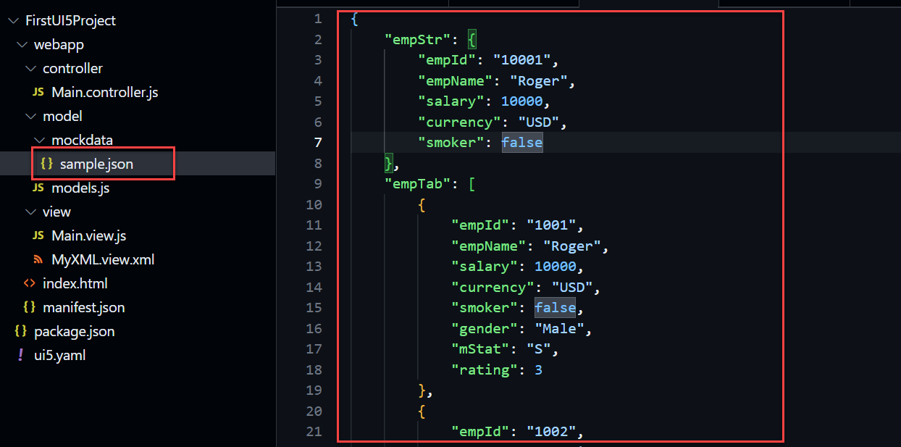
Hands – on: Loading data from file
Till now we have loaded the data in the model from the json structure only.
Now we will load the data into the model from a file.
There will be now change in the output but now the data will be loaded from the sample.json file
Code Links
sample.json
models.json

Slide 13
Concept of Named Model
Concept of named model comes into observation when we want to use more than one model simultaneously in one application. When we uses two model simultaneously the there are some conflicts arises in the application , as the second model we use will overwrite the data of the first model. So, here we use the Named Model
Creation of Named Model :
this.getView().setModel(oModel2 , “Name of the model”) ;
For example :
this.getView().setModel(oModel2 , “thanos”); → here thanos is the name of the model
Binding using the Named Model:
So in binding we use this name, to bind the data from the named model we use modelName>path in binding syntax
For example:
“{thanos>/empStr/empName}” this will bind the name from thanos model.

Slide 14
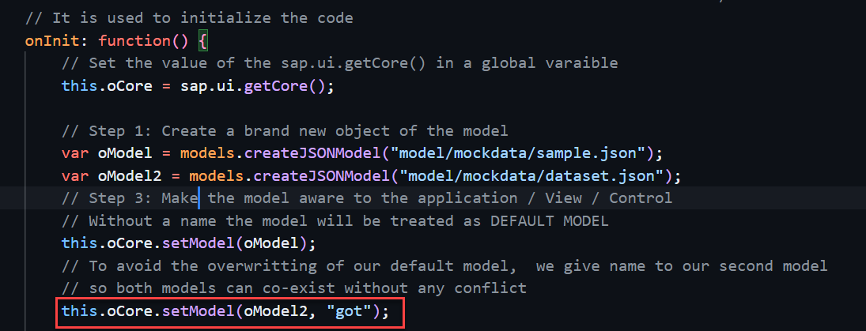
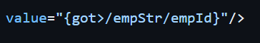
How to create a Named Model
Create a model (dataset.json) in the models folder .
In controller , we have to give the path in the createJSONModel() function
In model.js we have to pass the path as a parameter to create the model with different paths form the same function.
To bind the data in view , we have to use the name of the named model.

Slide 15
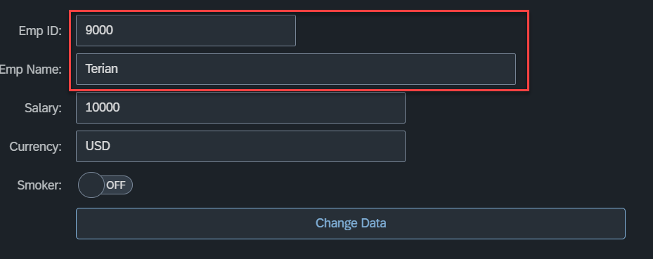
Hands – on: Named Model Creation
Till now we have loaded the data in the model from the json structure only.
Now we will load the data into the model from a file.
There will be now change in the output but now the data will be loaded from the sample.json file
Code Links
dataset.json
models.json
Main.controller.js
MyXML.view.xml

Slide 16
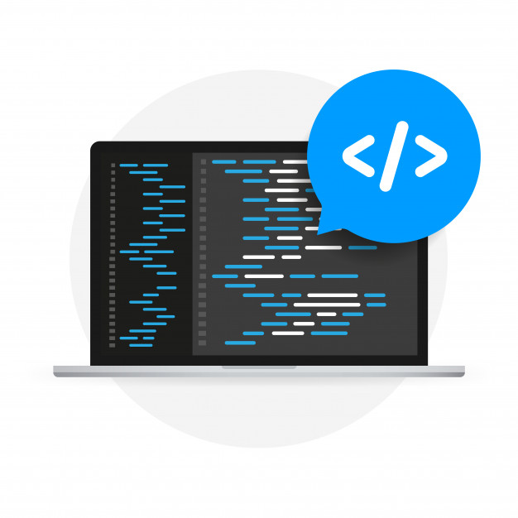
Expression Binding
Expression binding : - When we bind an Expression ({= condition ? true : false}) with the property of a control rather binding value to a property, this is called expression binding.
If we need some calculation on model data or some sort of comparison, then expression binding is useful.
Syntax:
numberState = “{= ${path} > value ? ‘conditionForTrue’ : ‘ConditionForFalse’ }”
Use Case of Expression Binding
My Manager want to add a make salary field grayed(read-only) whenever the employee name is Anubhav.
If The Employee Name is Anubhav, the salary must be 20000.
Condition – if employee name = Anubhav
Outcome – the salary must be 20000
Target – Salary field

Slide 17
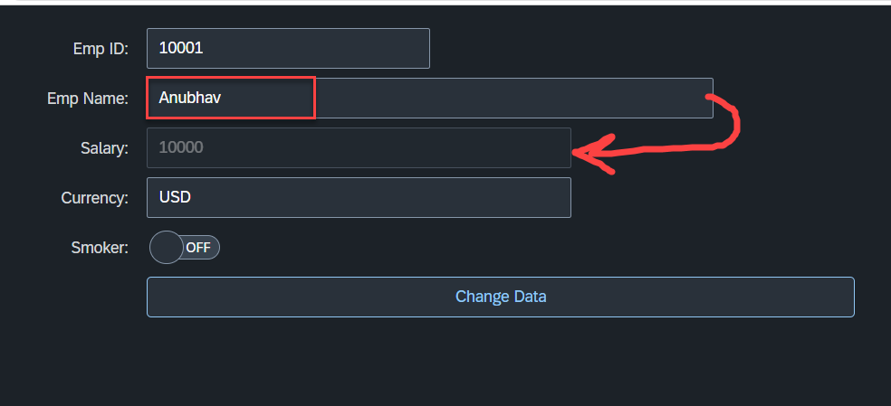
Hands – on: Expression Binding
Now we will bind the Salary field in the SimpleForm with the help of Expression binding Syntax according to the use case mentioned in the previous slide.
Before that we have to comment the line in the controller in which we are binding it form model.
Code Link:-
MyXML.view.xml
models.js

Slide 18
Aggregation Binding with Table Control
When we bind the aggregation of a control with the entityset of data model, it is called aggregation Binding.
The parent control (e.g. Table) is bound to the EntitySet path which is called absolute path and the child of the parent Control (e.g. Columns) are connected to the child properties of the EntitySet is called relative path.
In aggregation binding, based on your model data, as many child controls will be created automatically.
Every Event of UI5 will trigger the eventHandler and we will get the Event Object as part of the event Handler. Depending on the event, the event handler object will have different parameters.
Use Case of Aggregation Binding
If we want to show a list or some data in tabular format, we need to bind a group of data. In such a case we will use aggregation binding.
Absolute path
{
“empTab”: [
{
“empId”: 50,
“empName”: “Jay”,
“salary”: 9500
}
]
}
Table = {/empTab}
Emp Id | Emp Name | Salary
{empId} | {empName} | {salary}
Relative Paths

Slide 19
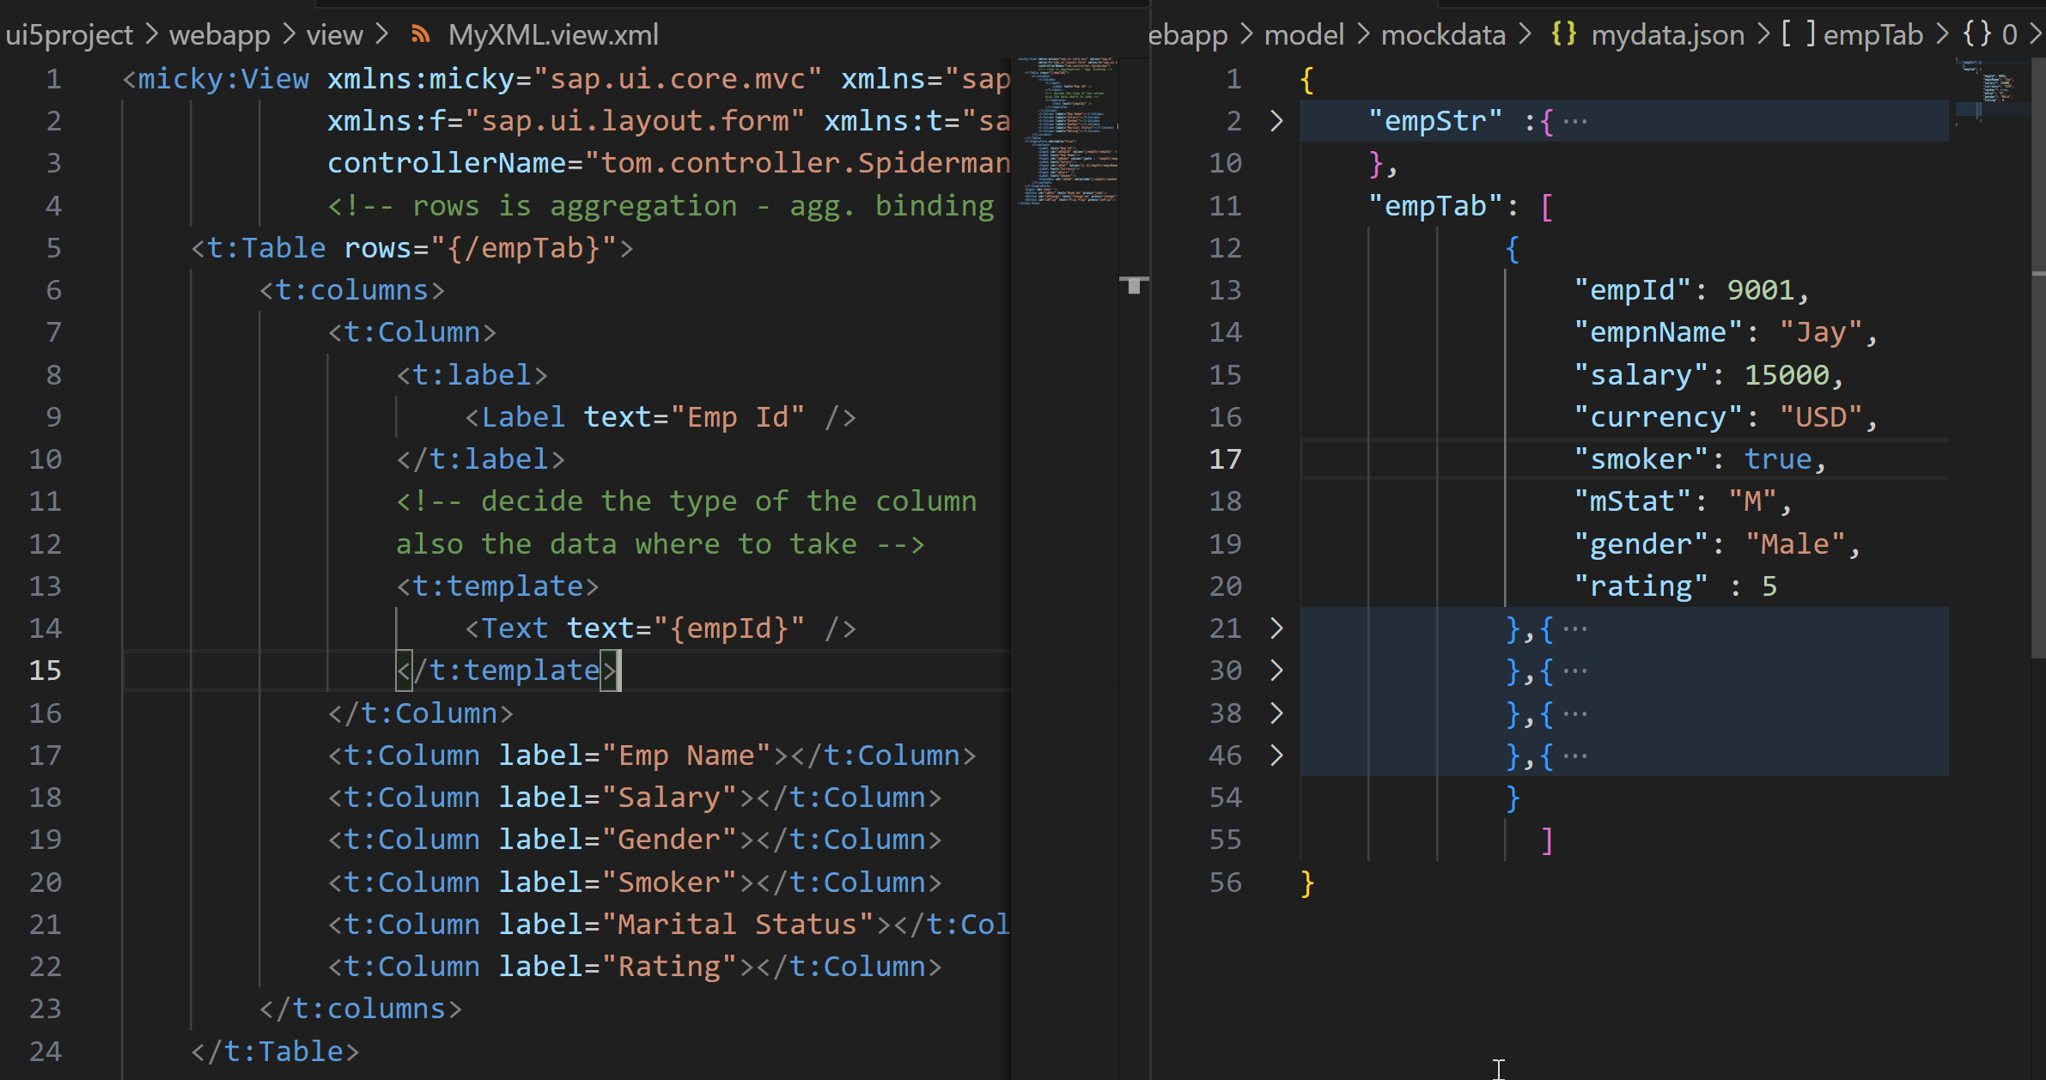

Slide 20
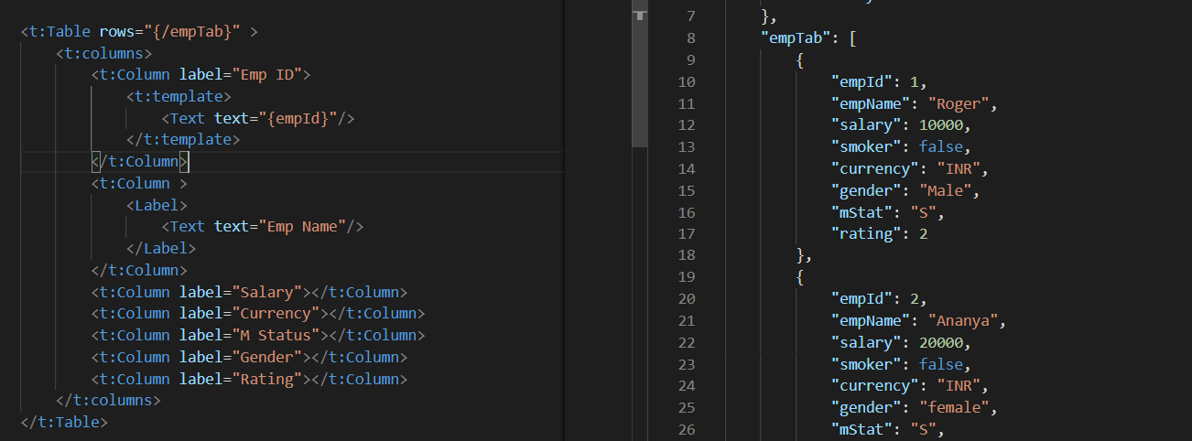
Absolute Path : Connecting parent to parent
Relative Path : connecting child to child respective to parent control

Slide 21
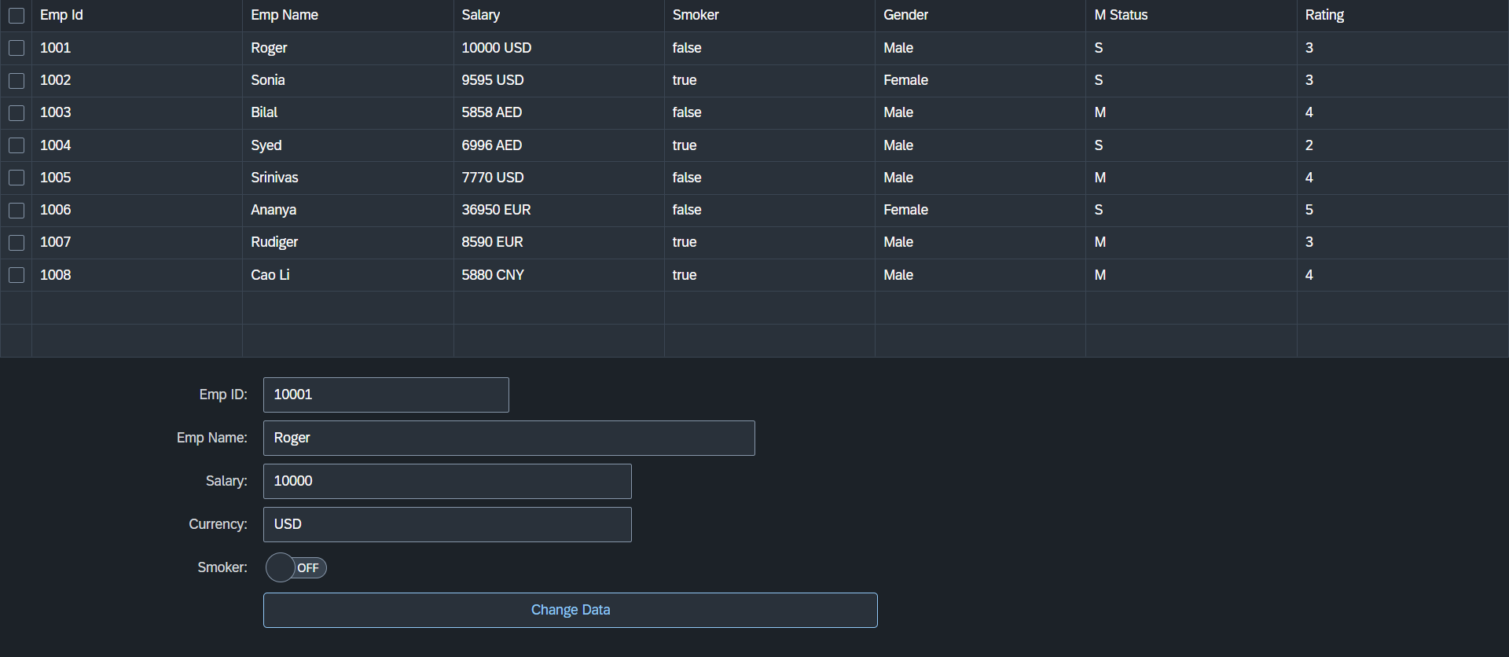
Hands – on: Aggregation Binding & Table
Now we will see how the Aggregation binding works with the help of the table control in SAP UI5.
Documentation of Table control:- https://sapui5.hana.ondemand.com/#/api/sap.ui.table.Table
Code Link:
Main.view.xml

Slide 22
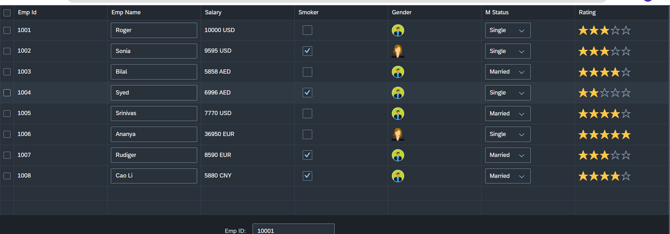
Hands – on: Table with Different Controls
Now we will add different type of controls to the UI table, like Input field, Image, Select, Rating Indicator, Check Box etc.
Code Links:-
MyXML.view.xml
sample.json

Slide 23
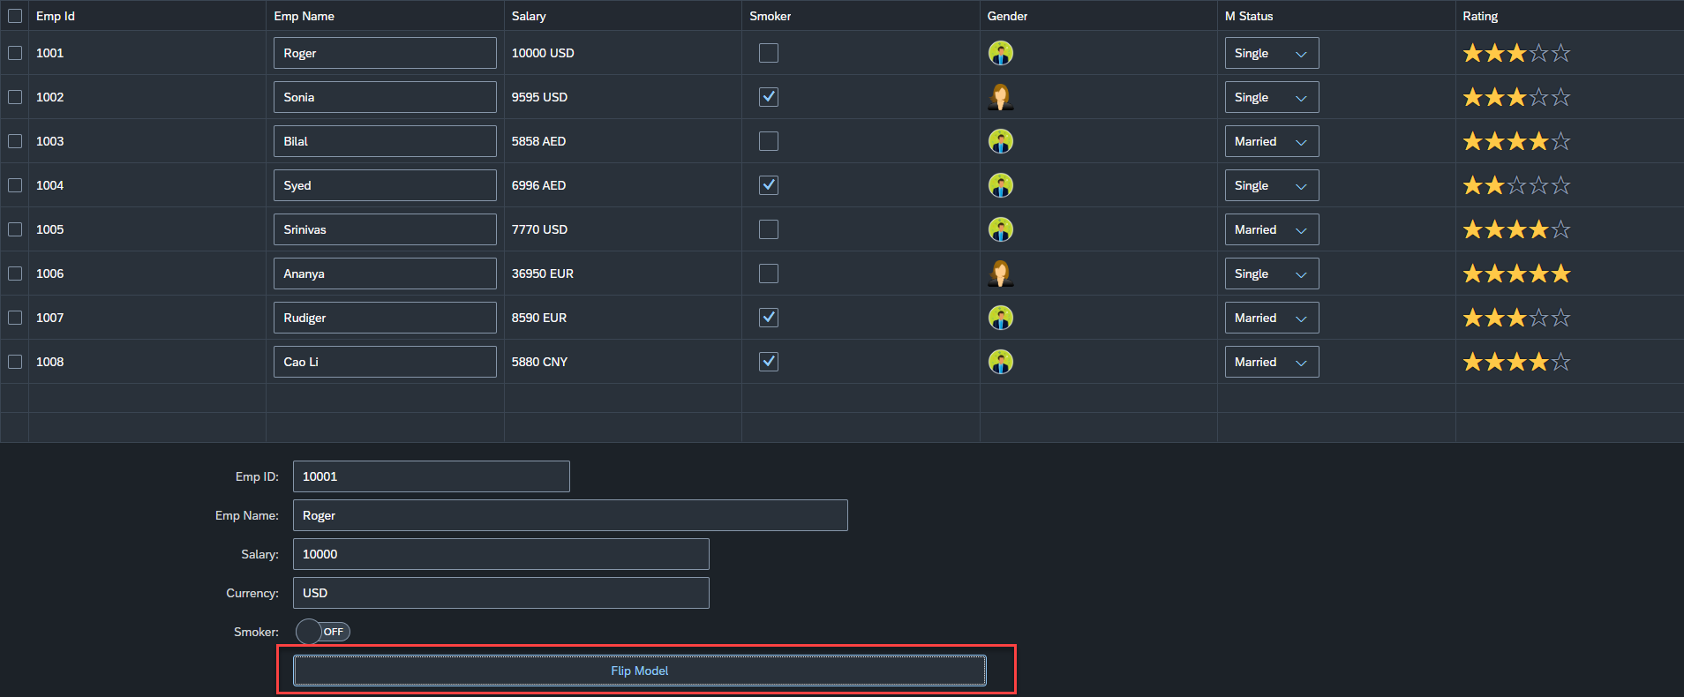
Hands – on: Flipping the default Model
Now we will change the default model in in the application on press of a button in the ui.
For this we will create a Flip button on the ui the default model bind to the application will be changed every time. (Flip Flop).
Along with that we will set the Visible number of rows in the Table to 5.
Code Links:-
Main.controller.js
MyXML.view.xml

Slide 24
Element Binding
To Understand the element binding first we have to understand about the what is element.
Element : Data related to the table inside the model memory is called as element ,
so, if we have 10 elements in the model we will get eventually 10 rows in table at runtime.
“empTab": {
"empId": 1,
"empName": "Roger",
"salary": 10000,
"smoker": false,
"currency": "INR",
"mStat": "S",
"rating": 2
}, ,
{
"empId": 2,
"empName": "Ananya",
"salary": 20000,
"smoker": true,
"currency": "INR",
"mStat": "S",
"rating": 4
}
Id | Name | Salary
1 | Roger | 10000
2 | Ananya | 20000
Element 0
Element 1

Slide 25
Element Binding continues..
Element binding is useful for containers and layouts containing other controls. All these child controls would be required to use properties of the same model object or model node, then element-binding is preferable.
An element to be bound to an object in the Model can be achieved by Element binding.
Use case:- On Select of a row in the table show the row data in a form.
The path of the element will always be the :
/entitysetname/index of the element
Table
Emp Id | Emp Name | Salary
{empId} | {empName} | {salary}
Element 0
/empTab/0
/empTab/1
/empTab/2
Element 1
Element 2
Simple Form
Field 0
/empId
All the content of Row 1 in the table is bind to all the fields in the form
Field 1
/empName
Field 2
/salary

Slide 26
Event Object Concept
Every UI5 event handler method will be entitled to receive an object free in the function, this object is know as event object.
This object is responsible to carry important information about the event.
For example : the rowSelectionChange event’s event object will let you know about the index of the row selected by the user.
Every Event object in SAPUI5 have exact 3 same function which are generic :
getSource() : will give the object of the source control from where event was originally generated. We can get object of the control, we can use it without giving an id.
getParameters() : every event carries a lot of the information about the user action e.g. row index of the selected row of the table. All this info come in form of parameters.
getParameter() : if we want to get single parameter value we can get it using this getParameter() function.
Note : best practice to use event object is put oEvent in the function’s parameter and using a hard debugger and then check the information got by the event object in browser’s console.

Slide 27
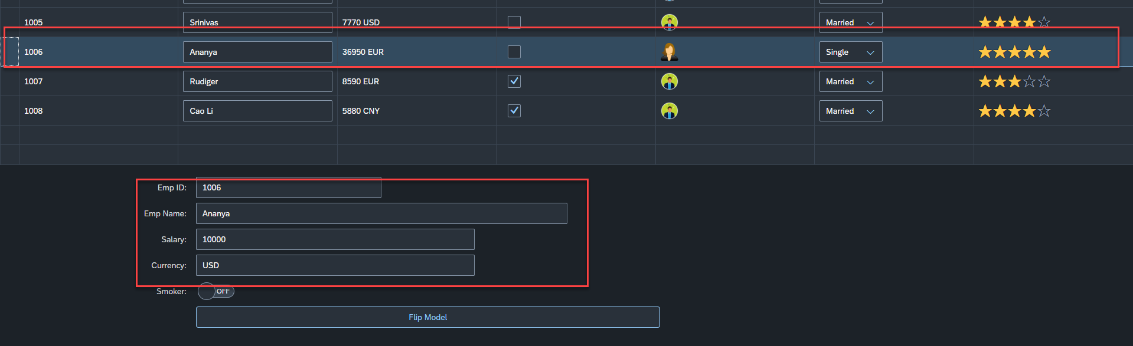
Hands – on: Element Binding
Make the table rows from multiselect to single select.
On select one row the data of that row have to shown in the SimpleForm by using the event object and element binding discussed in the previous slides.
Code Links:-
MyXML.view.xml
Main.controller.js

Slide 28
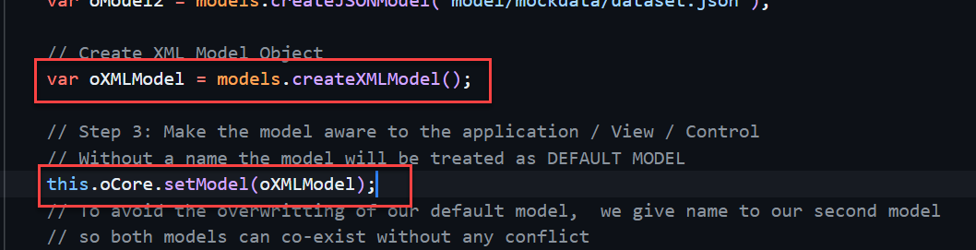
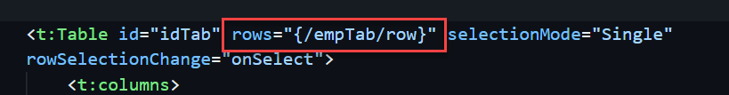
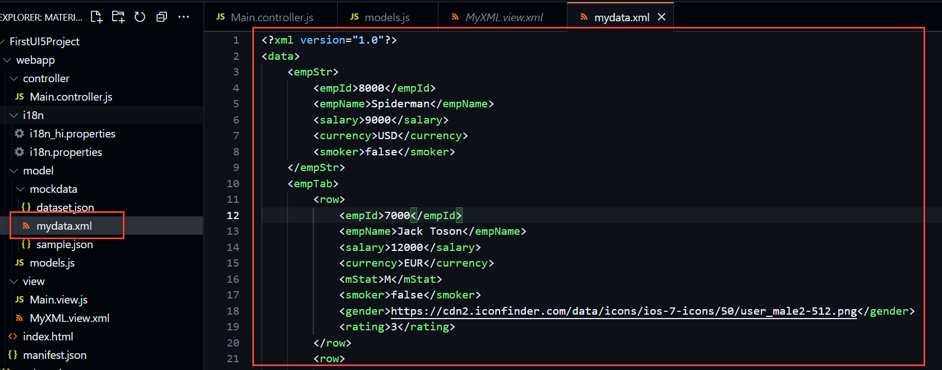
Hands – on: XML Model
The XML model allows to bind controls to XML data. It is a client-side model intended for small data sets, which are completely available on the client. The XML model does not contain mechanisms for server-based paging or loading of deltas. It supports two-way binding.
Code Links:
mydata.xml
models.js
Main.controller.js
MyXML.view.xml

Slide 29
Resource Model
We build software for international audience, we cannot just hardcode every screen element in English, if it requires multi-lingual support, we need to add resource model.
i18n → Internationalization : Make the app available for international usage, which means supporting multiple languages.
There are 2 job roles in the process:
UI5 Consultant
Language Expert KM
?sap-ui-language=hi
Implement the model to provide support for internationalization
Translate the texts to provide support in multiple languages
I18n.properties
TEXTS
Language specific

Slide 30
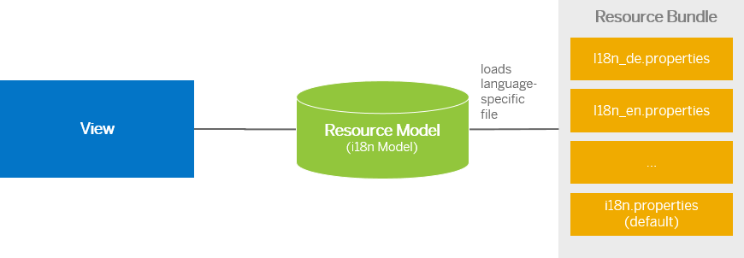
Steps to Create a Resource Model
Create resource bundle which includes label field
Create a folder i18n and inside this folder the file named i18n.properties for default labels.
And i18n_langcode.properties for different languages
Set The model
For more information about i18n you check the link
https://openui5.hana.ondemand.com/1.34.9/docs/guide/831039835e7c4da3a8a0b49567573afe.html
We can change the language of the app by adding ?sap-language=language_code at the end of the URL of the app. Example for Hindi we will write ?sap-language=hi

Slide 31
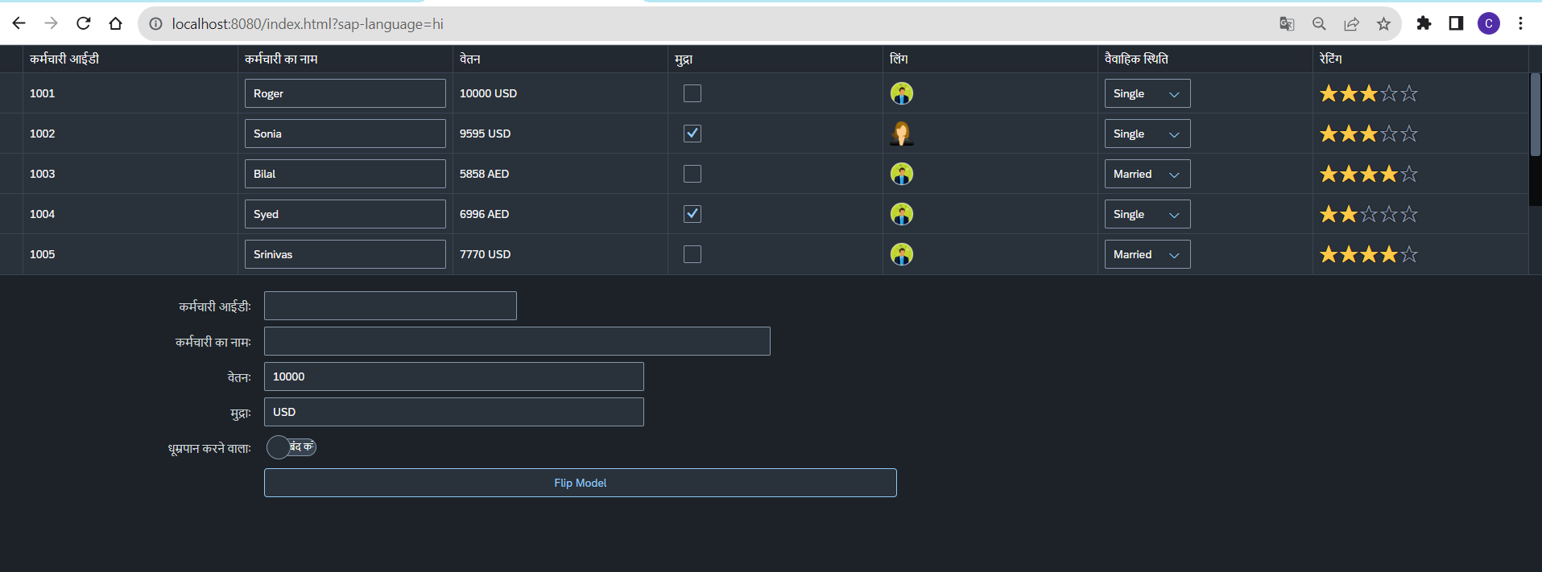
Hands – on: Resource Model
Now we will see how the language of an app is changed using the i18n file.
We have to create a folder ‘i18n’ in webapps folder and in the folder, we have to add files named ‘i18n.properties’ and one another file named according to the language we want. For example:- for Hindi language the file is named as ‘i18n_hi.properties.
Code Links:-
MyXML.view.xml
Main.controller.js
models.js
i18n.properties
i18n_hi.properties

Slide 32
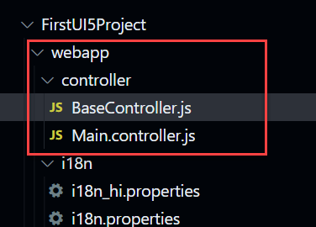
Concept of Base Controller
Base Controller:- A base controller is a controller with basic functionalities from which the other controllers in your SAPUI5 application inherit.
The base controller holds basic functionalities that are used across multiple controllers.
The base controller itself is just another JavaScript file and it does not have the .controller prefix. Just BaseController.js and not BaseController.controller.js.
We can use base controller to write all the reusable function and can also declare the global variables to use them across all the controllers.
The base controller goes in the controller folder in your SAPUI5 application folder structure:
sap/ui/core/mvc/Controller
BaseController
x becomes truly global
x
Controller 1
x
Controller 2
x
Controller 3
x
Controller 4
View 1
View 2
View 3
View 4

Slide 33
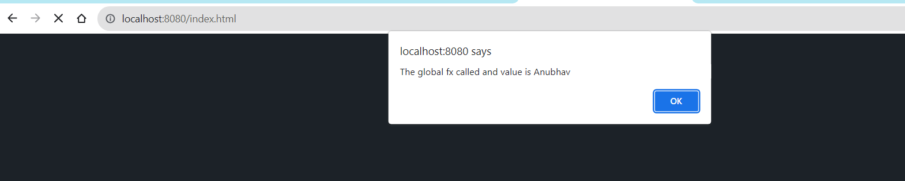
Hands – on: Base Controller
Now we will create a base controller and create a reusable function in it.
We will use that reusable function in our main controller.
Code Link:
BaseController.js
Main.controller.js

Slide 34
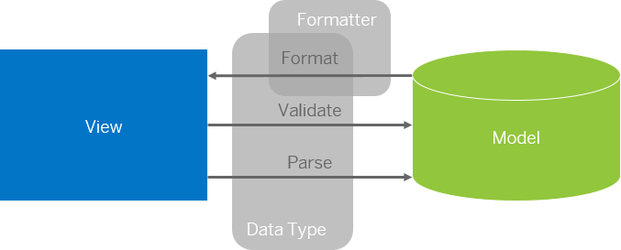
Formatter in SAP UI5
Formatters are used to define the formatting of data on the UI while data types work in both directions: they format the data on the UI and parse and validate user input that is entered.
Formatter is a function; This function gets called JUST Before the binding takes place with the view.
Formatter file is placed in a folder in webapp folder, and the file can be named anything with the .js extension.

Slide 35
How formatter works
Use Case: We want to display the name of the employee in Upper case to do we have to approaches
Changing all the employee name in the file.
This approach is time consuming, high maintenance and not practical in case of very large data.
Using a formatter function to convert the employee name in upper case at runtime.
In this approach we will use a reusable function which will convert the name in upper case at run time
This approach is low maintenance, and we don’t have to worry about the output as it will be handled inside the function.
Binding Syntax of the formatter:
propertyName=“{path: ‘pathName’, formatter: ‘.formatterFunctionName’}”
Working of the formatter:
Value at the path will be passed as a Input parameter in the formatter function
propertyName=“{path: ‘pathName’, formatter: ‘.formatterFunctionName’}”
Output value from formatter function will be passed to the property

Slide 36
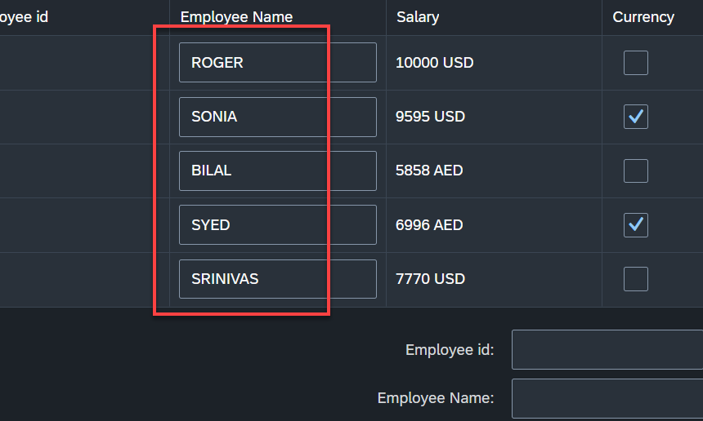
Hands – on: Formatter
Now Create a formatter to format the employee name in table to uppercase.
Code links:-
MyXML.view.xml
Main.controller.js

Slide 37
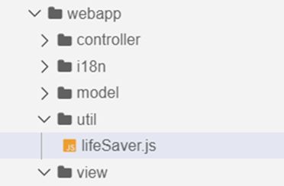
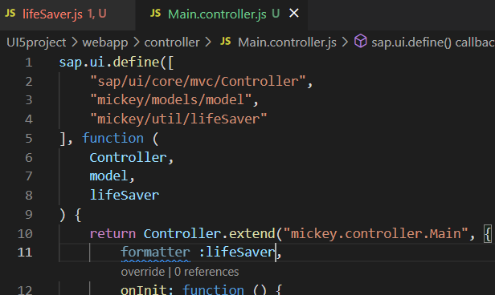
How to modularize formatter
To modularize a formatter first create a utils or util folder inside the webapp folder.
Now create a file lifesaver.js (you can give any name) inside the util folder .
Inside the file (lifeSaver.js) create the function(convertUC) for formatting.
After creating this function , inside the controller include it as a dependency and create a global variable at controller level which is accessible in the current view.
Now bind the formatter inside the view by using the second property binding syntax.
{path: ‘ ’ , formatter : ‘.formatter.formatterFunction’}
Formatter
The first dot represent that the it is in the controller

Slide 38
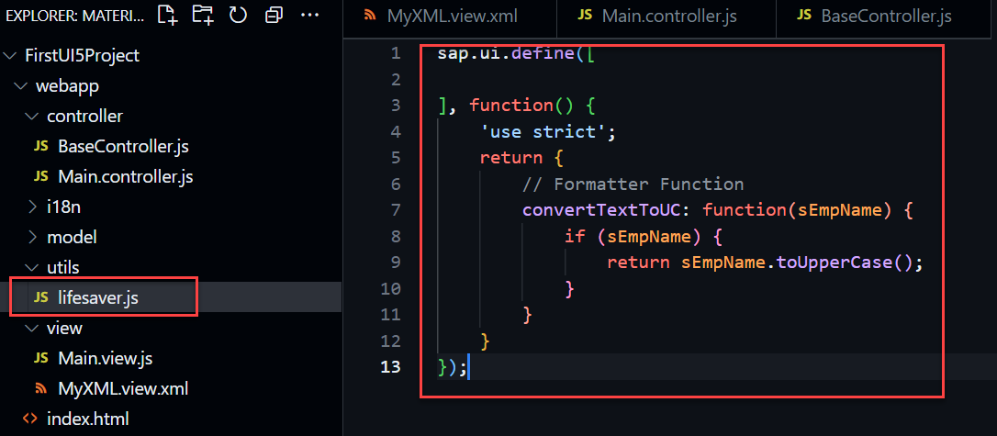
Hands – on: Modularize Formatter
Now we will modularize our formatter code by creating a new reusable JavaScript file for the formatter.
There will be no change on our current output.
Code links:-
MyXML.view.xml
Main.controller.js
BaseController.js
lifesaver.js

Slide 39
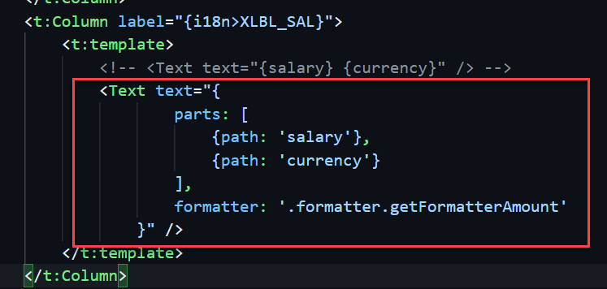
How to apply formatter for multiple path
When we there are two fields bind in one
for e.g:
Here we have to bind in a little different format and the format will be
“{ parts : [{path : ‘salary’},{path : ‘currency’}] , formatter : 'formatter.formatterfunction’ }”

Slide 40
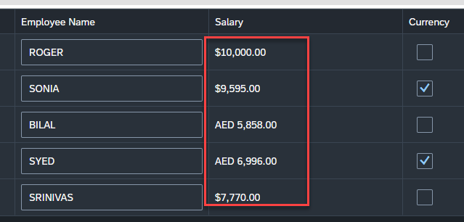
Hands – on: Currency Formatter
Now we will format the currency amount for the employee salary.
We will format the number according to the currency and also display the currency symbol.
Code links:-
MyXML.view.xml
lifesaver.js

Slide 41
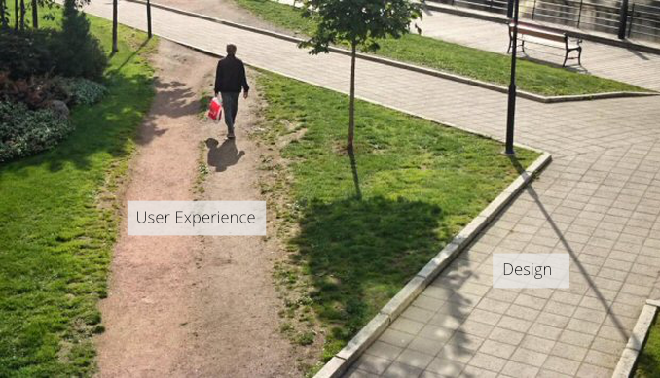
User Experience v/s User Interface
UI stands for user interface but UX stands for User Experience
UI is technical view point of our application interface which will be used to take and provide information to the user but UX is psychological and emotions of the app.
We can change the UI but we cannot change UX
Take an example of modern world of apps, where no one needs to give you training to use amazon, uber, eBay etc.
User interface is developer oriented. This is purely technical. We can change UI any number of times.
User experience is user oriented. It is psychological. We cannot change UX.

Slide 42
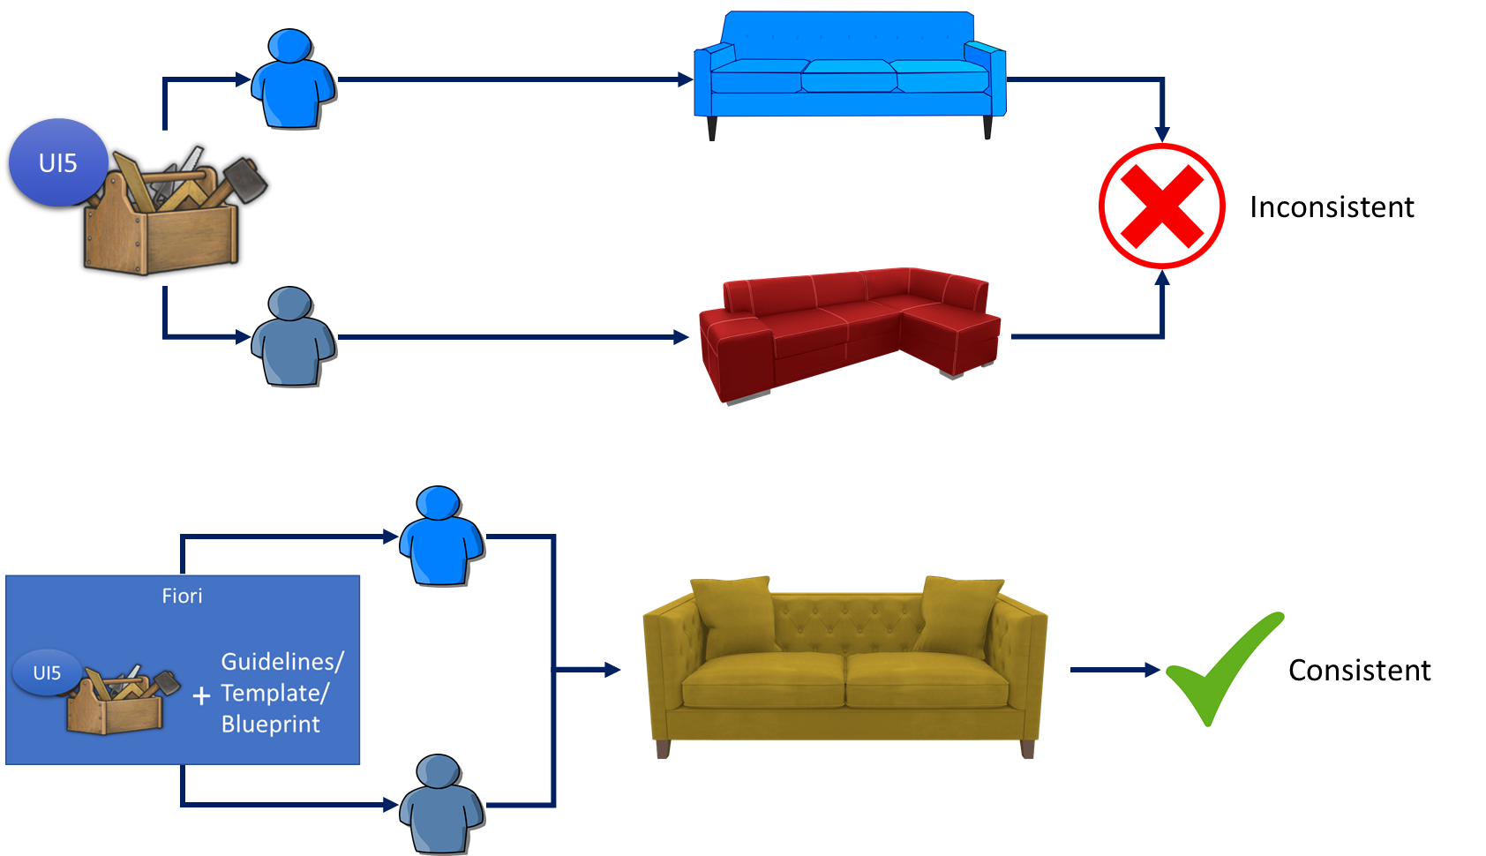
UI5 V/S Fiori
SAPUI5 is used to design UI but SAP Fiori is used to create User experience. Fiori apps are technically built on SAP UI5 only but they follow guidelines which are provided by sap and proven golden path for development of apps.
SAP Fiori provides also the pre-defined templates like master details, object list page, worklist etc. which brings our UI more closer to User experience.

Slide 43
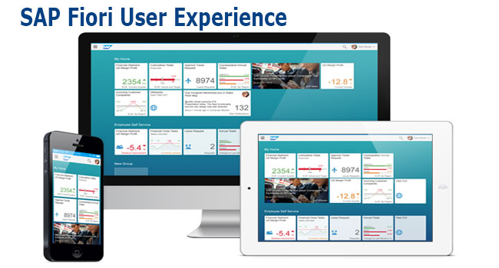
What is Fiori?
SAP Fiori is the user interface or user experience (UX) that supplements and can replace the SAP GUI. This streamlined application uses tiles to encapsulate standard tasks, such as approving purchase requisitions, viewing sales orders, and approving timesheets.
Fiori is SAP’s new user experience. These are standard apps delivered by SAP and by following the Development guidelines any one can use UI5 to create Fiori Apps.
Fiori is a streamlined application, delivering a role-based user experience that can be personalized across all lines of business, tasks and devices.
It uses tiles to encapsulate standard tasks like viewing sales orders or approving timesheets.
Fiori = UI5 + Development/Design Guidelines

Slide 44
Structure of a Fiori App
There are different folders and directory are required for setup project: webapp, Controller, models, utils ,view, Component.js, manifest.json, index.html
Structure of normal ui5 application
Index.html
View
Controller
Structure of Fiori Application
Dev.
sap/ui/core/UIComponent
Index.html
Root View
App.view.xml
Component.js
View 1
Controller 1
Container
App (pages)
View 2
Controller 2
manifest.json
App descriptor
App.controller.js
BaseController
Component.js is starting point

Slide 45
Component.js File
Component.js the starting point of all Fiori applications, it is used by Fiori Launchpad to kick-start our app. If an app has Component.js inside, it called Fiori like app.
We will decouple everything from index.html to avoid user starring app w/o launchpad because of security rick of user opening app direct from index file.
It is the wrapper of all the functionality.
The name of the file must be, must be Component.js
It should ideally be created inside the webapp folder
If our app does not have Component.js, we will not be able to integrate our app with launchpad
It is a class which inherits from sap/ui/core/UIComponent standard class. We inherit to reuse the functionality offered by SAP like routing.
When app starts, UI5 framework will scan your project’s base directory to check if it has a file with exact name Component.js
The component file calls the manifest file, and we keep all app level configuration inside the manifest file.

Slide 46
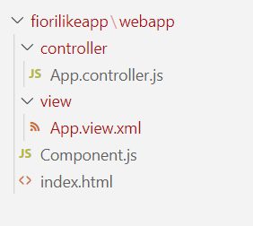
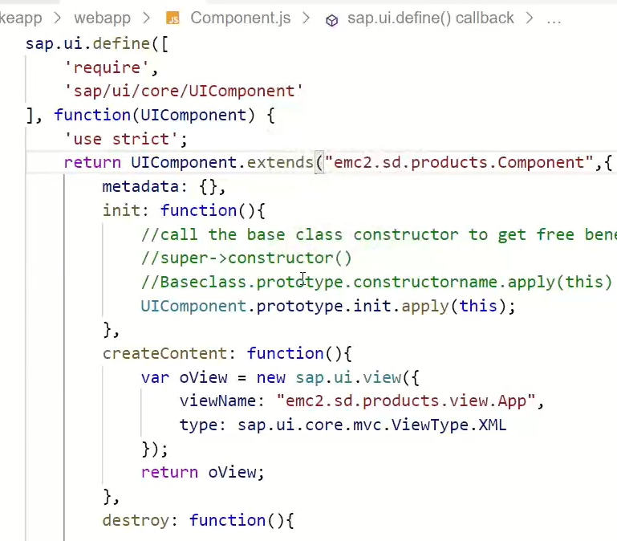
Hands – on: Create our first Fiori Like app
Create a new folder named fiorilikeapp in our projects directory, using the command mkdir fiorilikeapp.
Now navigate to the newly created folder using the command cd fiorilikeapp, and then create a webapp folder inside this newly created folder using the command mkdir webapp. Then move inside this folder using command cd webapp.
Now create two files in the webapp folder using the commands touch index.html and touch Component.js
After this create a App view and App controller in the respective view folder and controller folder.
Once the files are created paste the code from below links.
Code links:
index.html
Component.js
App.view.xml
App.controller.js
Namespace naming convention: “company.area.project”
Example:
ibm.fin.ar
emc2.fin.ar
ibm.hr.payroll
ibm.fin.ap

Slide 47
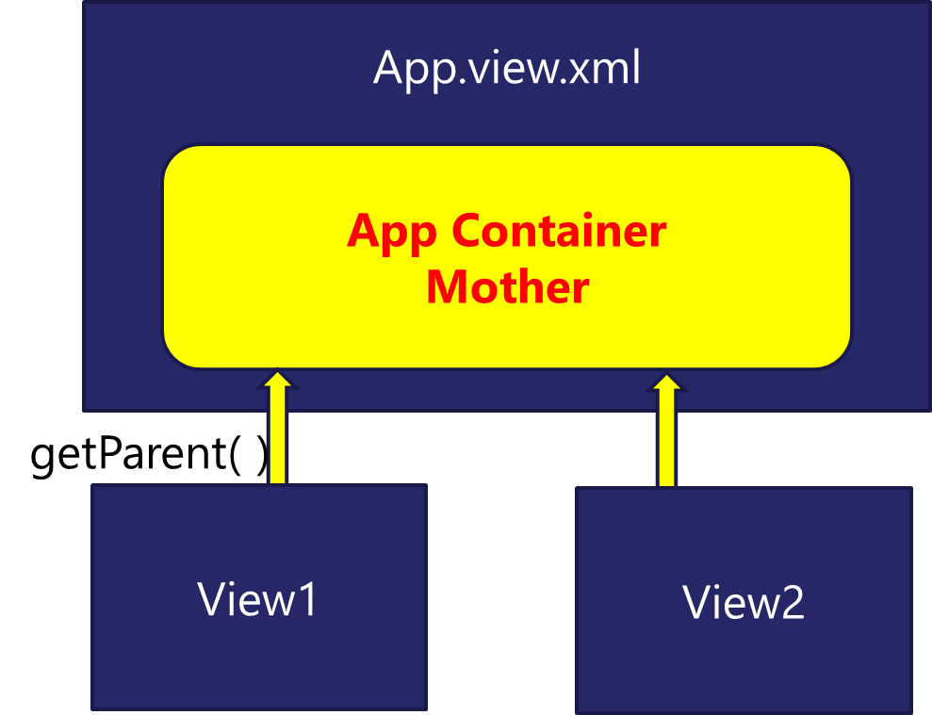
App Container
Most of the Fiori app developed in the industry used to have more than one view. To work with multiple views, we use the concept of Parent View in the Fiori application. Which means all the views are loaded in one Parent View(App View) which then calls the view we want to display to the user.
The App view will behave as a container for other views.

Slide 48
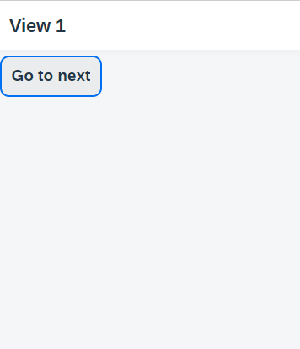
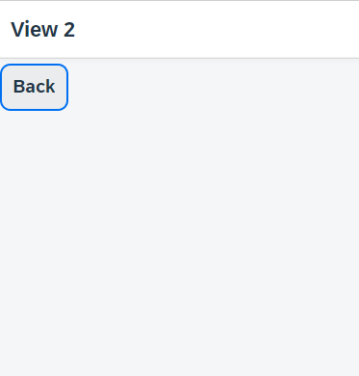
Hands – on: Working with multiple views
Now to understand how the app container works we will add two new views (View1 and View2).
Similarly we have to create a View1 controller and View2 controller.
Since we are using multiple controllers we should also create a Base Controller to inherit the controller class at one place.
Once these files are created, copy the code from below links.
For this exercise we will create a Button on both View1 and View2. On press of that buttons we will navigate to the another view. View1 to View2 and vice-versa.
Code Links:
App.view.xml
App.controller.js
View1.view.xml
View1.controller.js
View2.view.xml
View2.controller.js
BaseController.js
Component.js

Slide 49
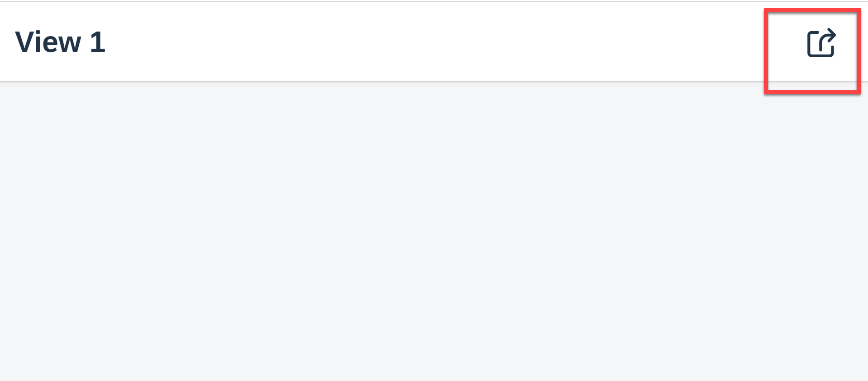
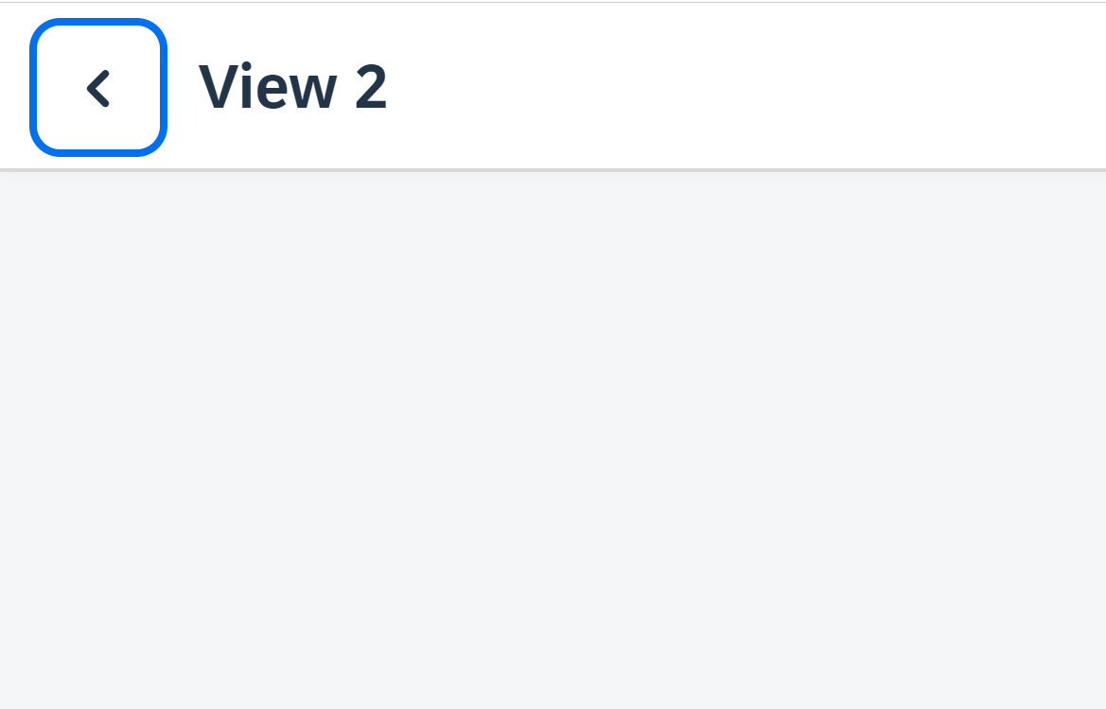
Hands – on: Header Navigation Buttons
As we see in most of the application the Navigation button are place inside the navigation bar at the top.
So we, will move the button to the Nav bar using the headerContent aggregation of the sap.m.Page control.
The standard page control also provides a some properties to add the Nav button without using the custom control.
Code Links:
View1.view.xml
View2.view.xml

Slide 50
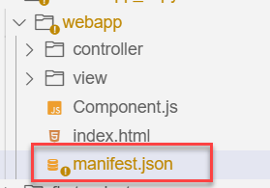
Manifest.json file
manifest.json is also knows as application descriptor file. When someone look at my application, my application descriptor will express all the necessary properties.
It contains all the configuration for our application.
manifest.json is a file which contains all the properties and initialization of our app. When app starts SAPUI5 framework will read this file and generate necessary artefacts out-of-box for us.
It is written in JavaScript Object Notation (JSON) format.
Reasons why we need manifest:
Once upon a time, I was in goa and enjoying my drink on beach, suddenly my phone rings and guess who is on the other side? You have developed a Fiori app last week and left for vacation, today we have a customer ticket and I am sitting with one your colleague, unable to understand what you did? Can you come and connect for some time.
A team member is leaving our team, he/she has developed 20 Fiori apps and now you suppose to take handover, she/he is not cooperating because they leaving, how will you hold on to the code?
SAP Delivers 1000s Fiori apps but they don’t send mobile no. of Labs developer. How will we understand where and what app is doing?
Documentation for manifest.json file: https://sapui5.hana.ondemand.com/#/topic/be0cf40f61184b358b5faedaec98b2da

Slide 51
Section of manifest.json
sap.app contains id, type, i18n, applicationVersion, title, description, dataSources.
sap.app
sap.ui contains technology, icons, deviceTypes, supportedThemes
sap.ui
sap.ui5 contains different components
rootView, dependencies, contentDensities, models, routing etc.
sap.ui5

Slide 52
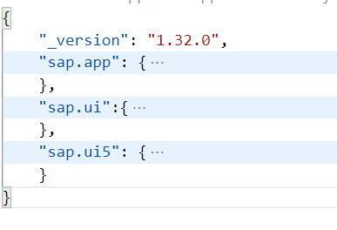
Hands – on: Create the manifest.json file
Now we will create the manifest.json file in our webapp folder.
Along with that we have to create the i18n folder and in that folder a i18n.properties file.
Then we have to add the required code to these file.
Also link the manifest to the Component.js file.
Code Links:
manifest.json
i18n.properties
Component.js

Slide 53

End of Day 6

Slide 54

Questions

Slide 55

Shekhar Vedi

Slide 56


We’re committed to empower you to be
Most Desirable Resource
through powerful training solutions.
We build the workforce of the future.
250+
Corporate Clients
30,000+
Learners Trained
25000+
Learners Placed
FREE WEBINARS
Sign up for free webinars with industry experts every fortnight!
Enroll Now!
Contact us today!
https://anubhavtrainings.com/

Slide 57




More from AnubhavTrainings.com

Slide 58
Title
Content

